Slide 1


THINK
AND
GET JOBS
Helping the international data science students strategize job search,
through an analysis of H1B visa data of
3 million observations from 2014 to 2018.
Ali & His GG Queens
Ali Yaqoob
Yasi Wang, Yilin Yang, Zekun Wang

Slide 2
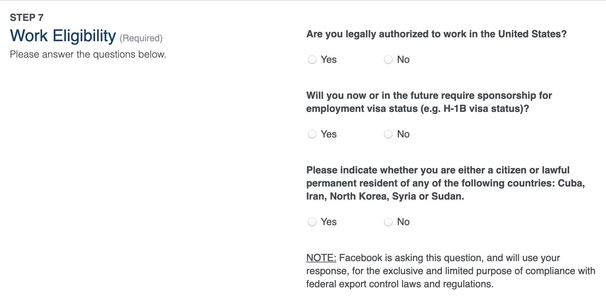
WORK ELIGIBILITY
Notes:
NOT
THIS ONE SHOULD BE IN PAGE 3? OR WHAT

Slide 3
01
BACKGROUND
An overview of H1B visas
02
WHY STEM
04
WHERE
Reasons why STEM is relevant to look at
Where you should be applying for and what to look at
03
WHICH JOBS
05
CONCLUSIONS
Different types of data related jobs and their trends
Big takeaways

Slide 4
01 BACKGROUND
An overview of H1B visas

Slide 5
01 BACKGROUND
The H1B Visa
Non-immigrant visa that allows companies in the US to hire international students for speciality occupations that require theoretical or technical expertise.
Minimum requirements
Bachelors
Job offer related to field of study within the US
Why is H1B popular
Dual-intent visa
Flexible
Accessibility
Term of stay = 6 years
Quicker than applying for permanenty residency

Slide 6
01 BACKGROUND
Timeline of Relevant Events
2014
2015
Investigation of outsourcing of technical tasks. Infosys laying off 500 technology workers.
Work-site regulations. Cannot be off site for more than 30 days.
2017 memorandum on computer-programming positions
President Trump signed an executive order to direct federal agencies to “Buy American, Hire American”
Deportation from the United States on rejection of visa extension
Implementation of Electronic H1B Registration Process
2016
2017
2018
2019
Notes:
In June 2015, ten Senators requested the U.S. Department of Labor open an investigation of outsourcing of technical tasks by Southern California Edison to Tata Consultancy Services and Infosys then laying off 500 technology workers.
Final ammendment on work site regulations is passed in 2016. H1B worker cannot be off side for more than 30 days.
2017 memorandum on computer-programming positions: An application for an H-1B visa for a computer programmer must sufficiently describe the duties and the level of experience and responsibilities of computer-programming positions in order to demonstrate how the position is a senior, complex, specialized, or unique computer-programming position rather than an entry-level position in order to qualify for an H-1B visa.
At a press briefing, the Department of Labor, Department of Justice, Department of Homeland Security, and Department of State said that an executive order will direct federal agencies to implement a new system that favors higher-skilled, higher-paid applicants.^{[121][122][123]} The executive order is the first initiative in response to a key pledge made by Trump during his presidential campaign to promote a "Buy American, Hire American" policy.^{[124]} The executive order is intended to order federal agencies to review and propose reforms to the H-1B visa system.^{[125]} Through the executive order, Trump stated his broad policy of economic nationalism without having to go through Congress. The Secretary of Labor, Attorney General, Secretary of Homeland Security, and Secretary of State^{[121]} will "fill in the details with reports and recommendations about what the administration can legally do."^{[126]} Trump said that the executive would "end the theft of American prosperity," which he said had been brought on by low-wage immigrant labor
On June 28, 2018, the United States Citizenship and Immigration Services announced that, when a person's request for a visa extension is rejected, the person will be deported from the United States.
Dec. 6, 2019. USCIS annouces imlementation of H-1B Electronic Registration Process for Fiscal Year 2021 Cap Season.
$10 feeU

Slide 7
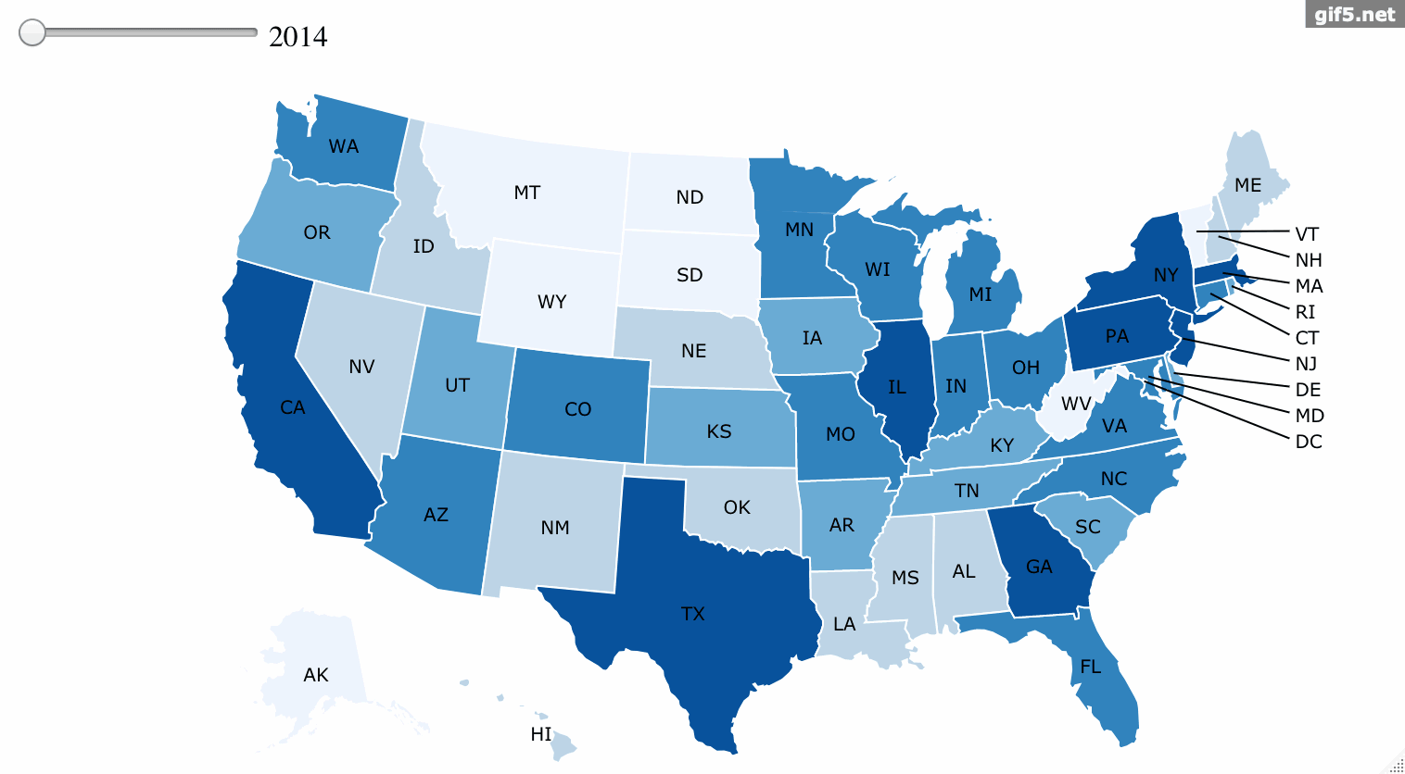
Number of Applications Per State
01 BACKGROUND

Slide 8
02 STEM
Reasons why STEM is relevant to look at

Slide 9
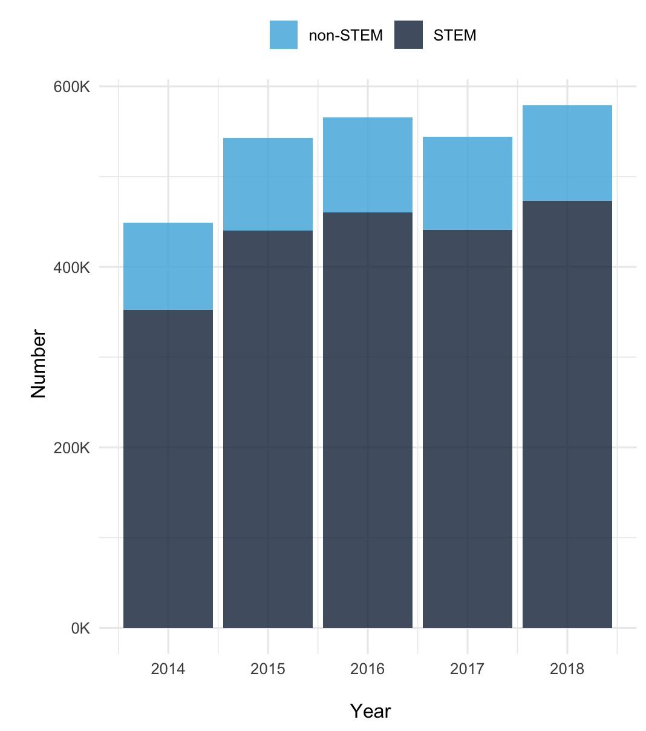
02 STEM
Portion of STEM Applications Per Year
More than 80% of all applications in each year are STEM related jobs
Three main reasons for this
3 chances for STEM international students
Higher number of jobs
More competitive salaries

Slide 10
02 STEM
Prevailing Wage Distribution Per Year

Slide 11
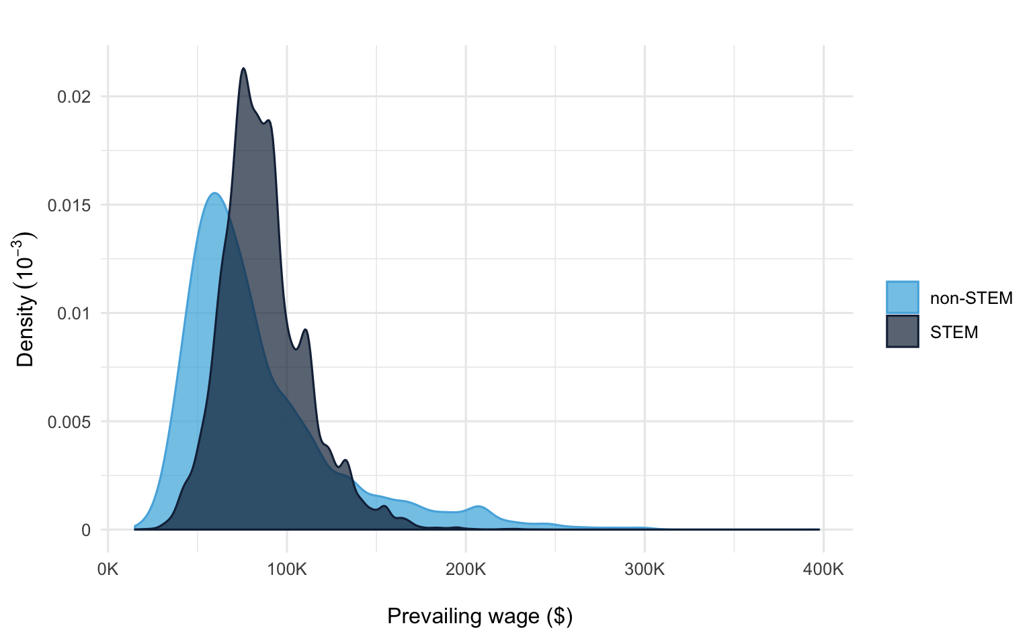
02 STEM
Prevailing Wage Distribution - 2018
Notes:
ste

Slide 12
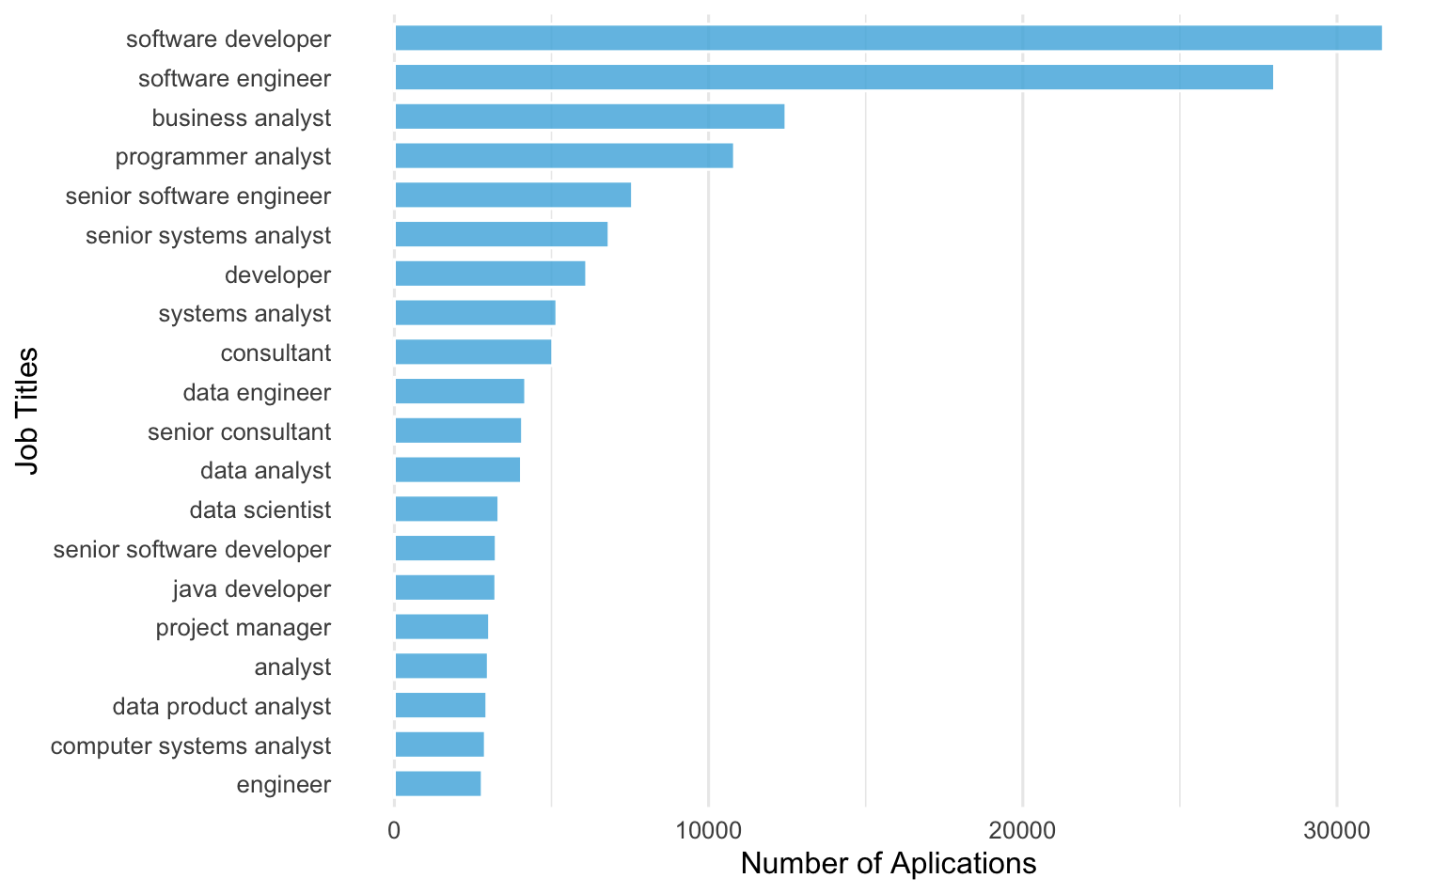
Top Jobs Within STEM In 2018
02 STEM
Notes:
Make the color for data related jobs different
Remove jc60
Fix the axes labels.
Add plot for 2017

Slide 13
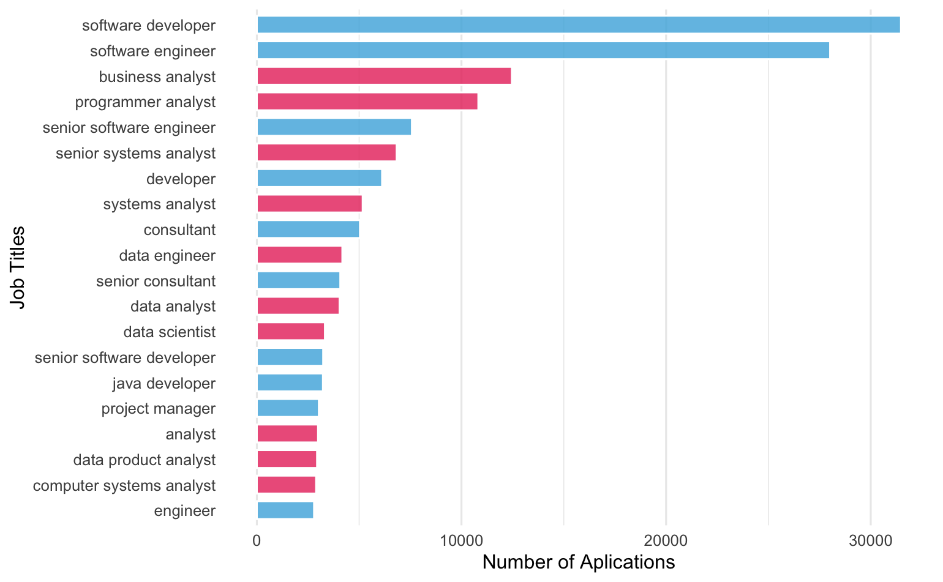
Top Jobs Within STEM In 2018
02 STEM
Notes:
Make the color for data related jobs different
Remove jc60
Fix the axes labels.
Add plot for 2017

Slide 14
03 WHICH JOBS
Different types of data related jobs and their trends
Notes:
There are so many applications in data related jobs. If you still have no idea for your career, we provide some information here. There are four main data-related roles: Business Analyst, Data Analyst, Data Scientist, and Data Engineer.
Thus, we grouped the data related jobs by categories.

Slide 15
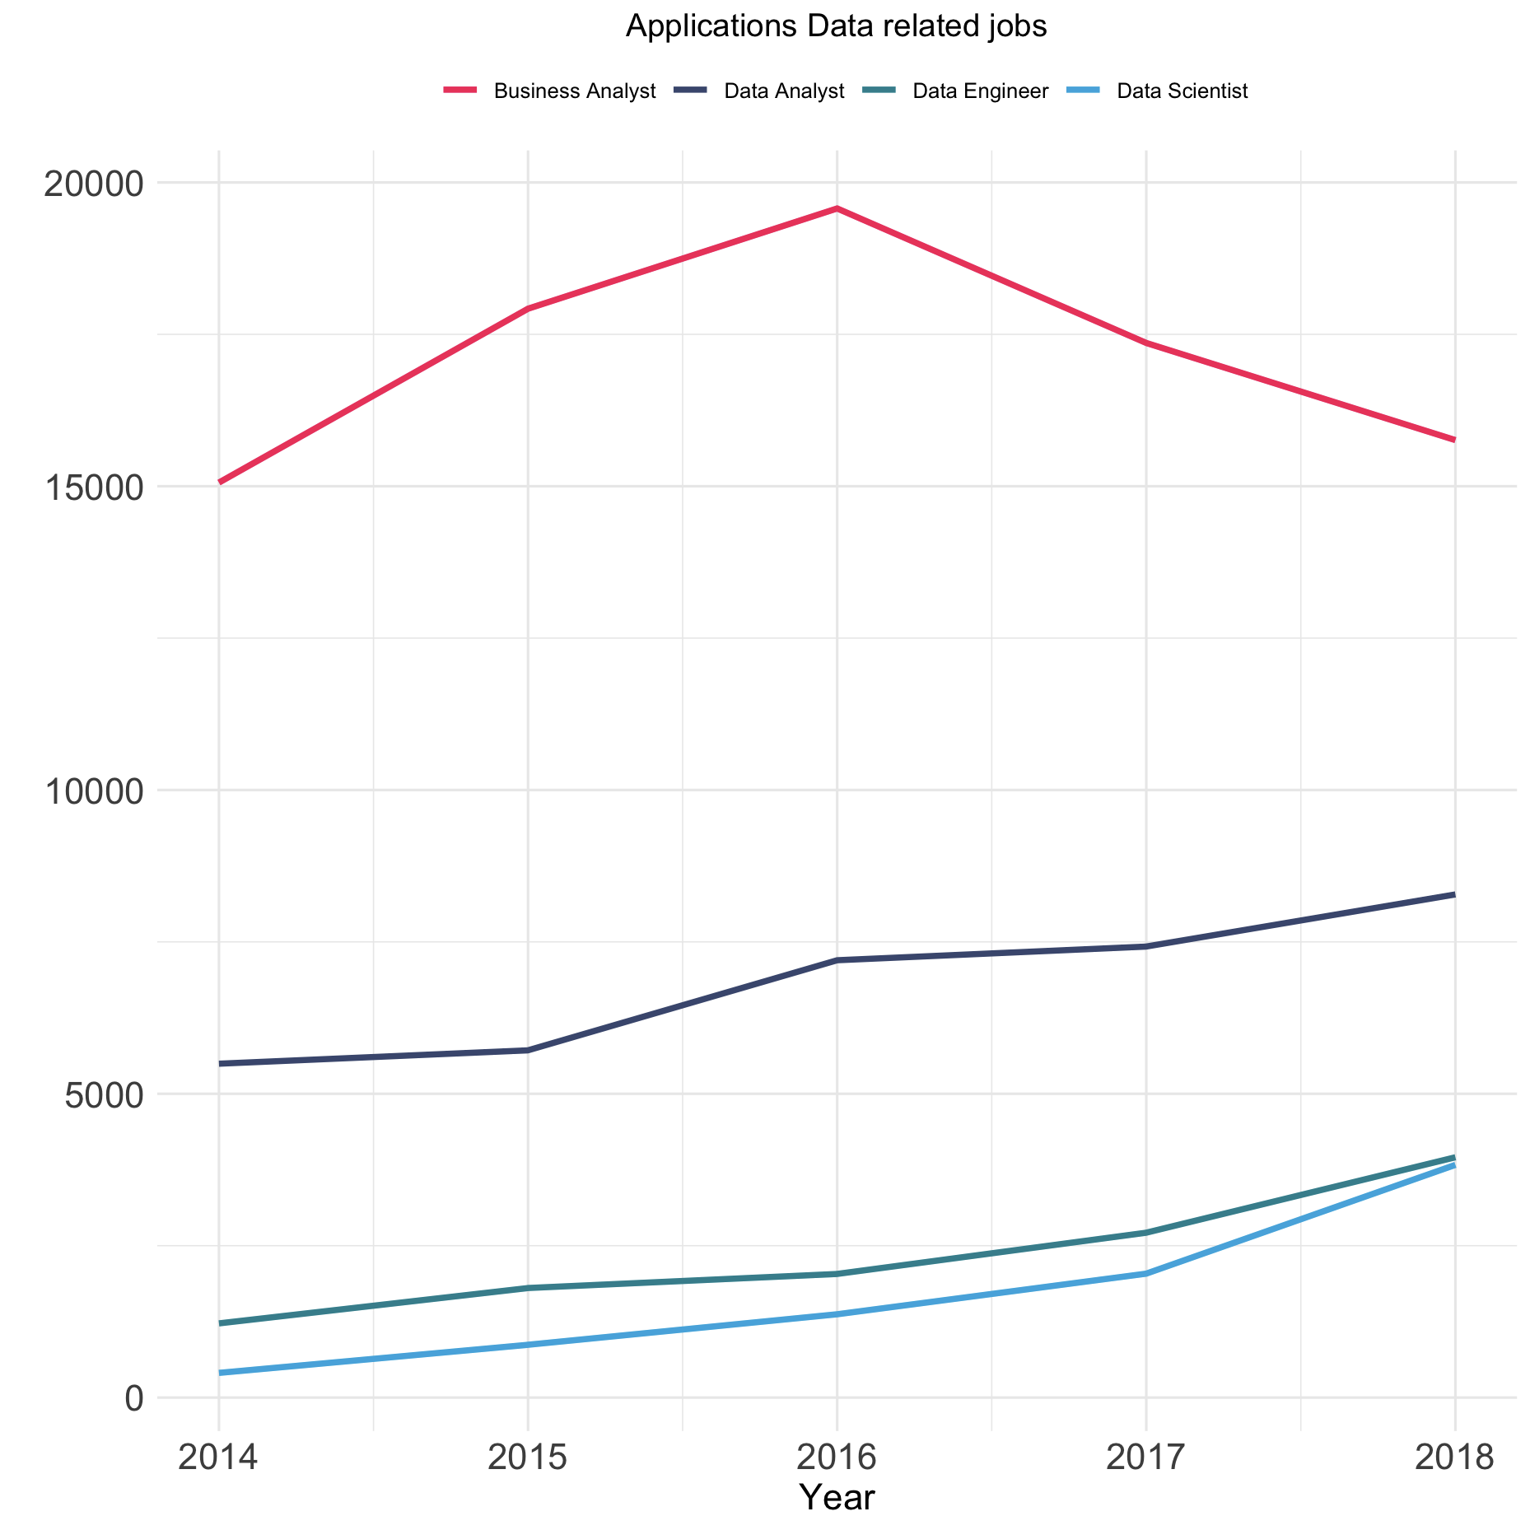
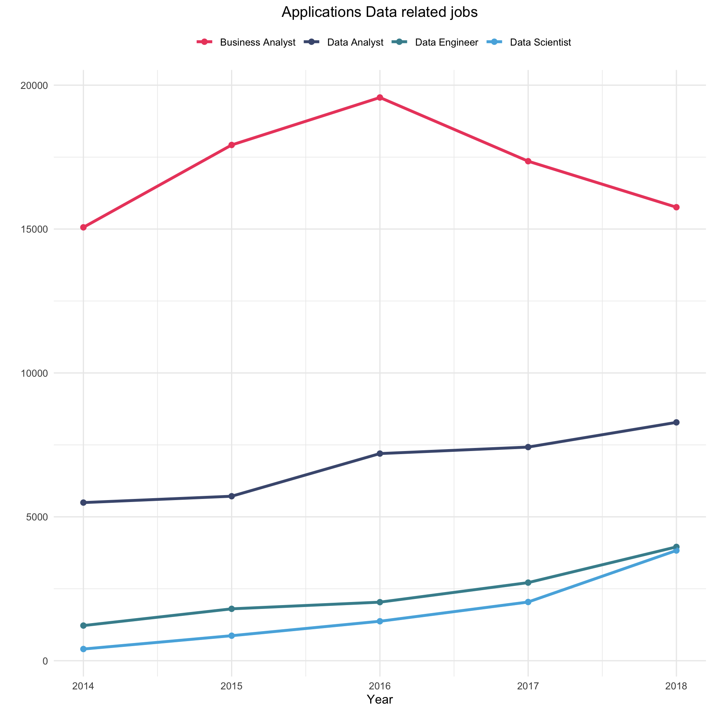
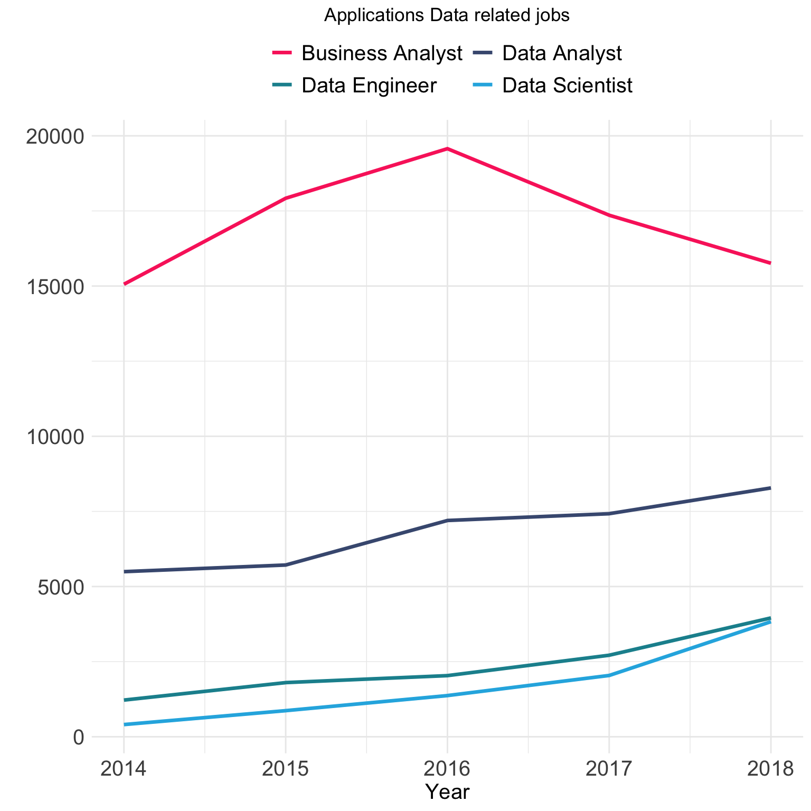
03 WHICH JOBS
Data Related Jobs And Their Trends
Business Analyst jobs the highest for all years but currently on the decline.
Data Scientist and Data Engineer jobs on the rise.
Data Analyst jobs leveling out over the years.

Slide 16
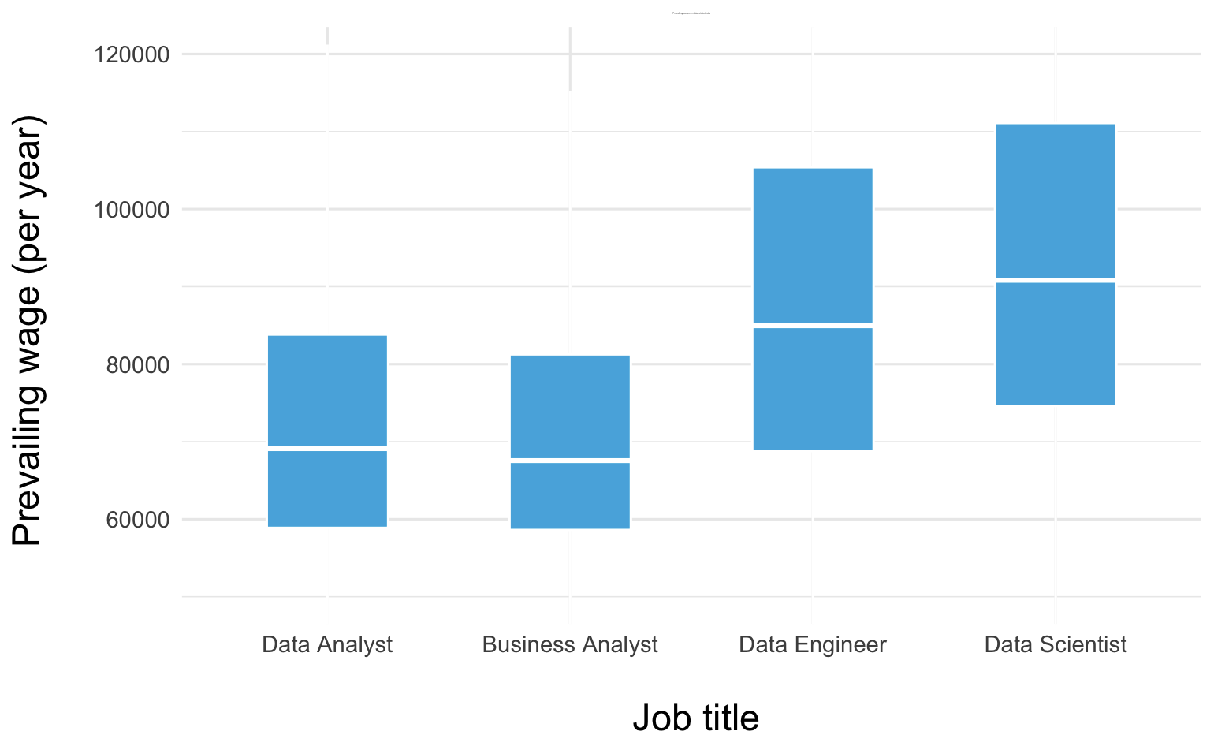
03 WHICH JOBS
Prevailing Wage of Data Related Jobs in 2018
Notes:
Salary disributions of different types od data science roles.

Slide 17
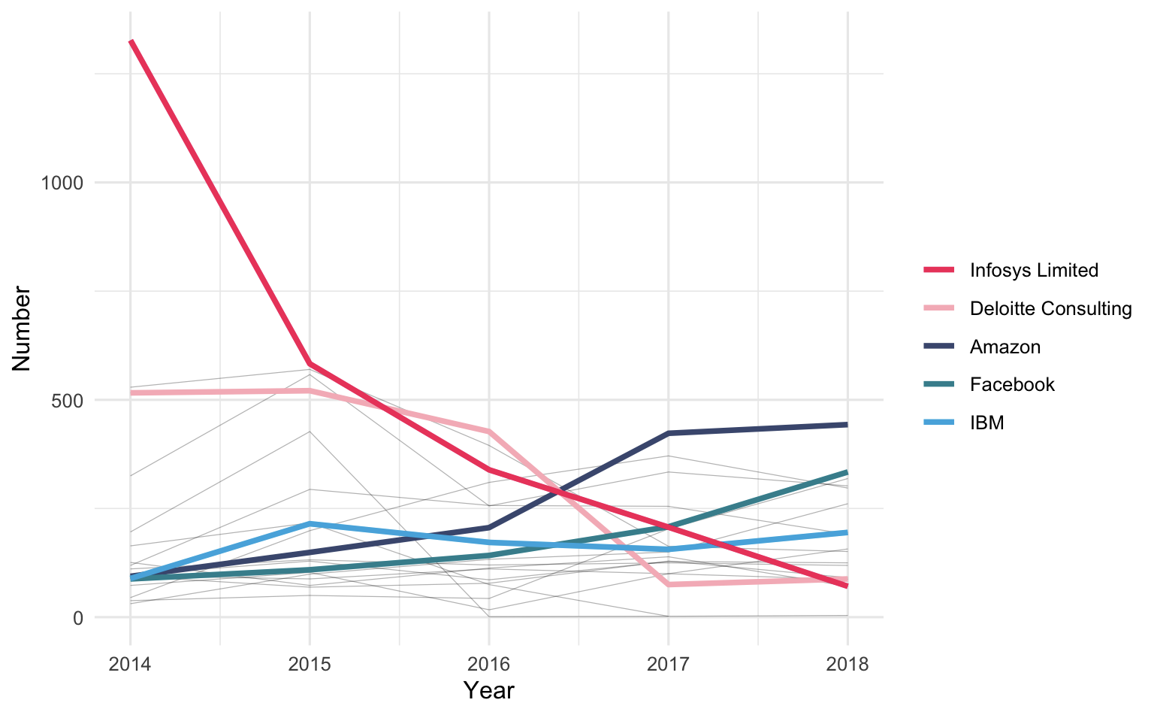
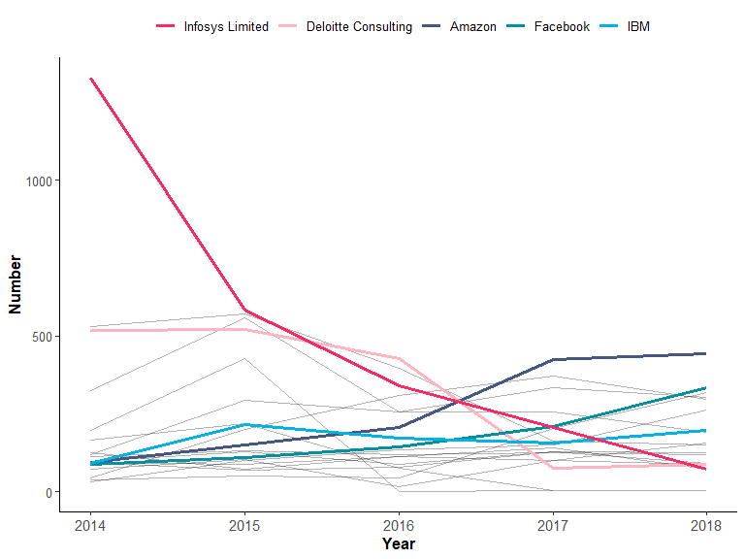
03 WHICH JOBS
Data Related Jobs And Their Trends
Notes:
filter by data related jobs and and show how top tech companies trends have changed for those.

Slide 18

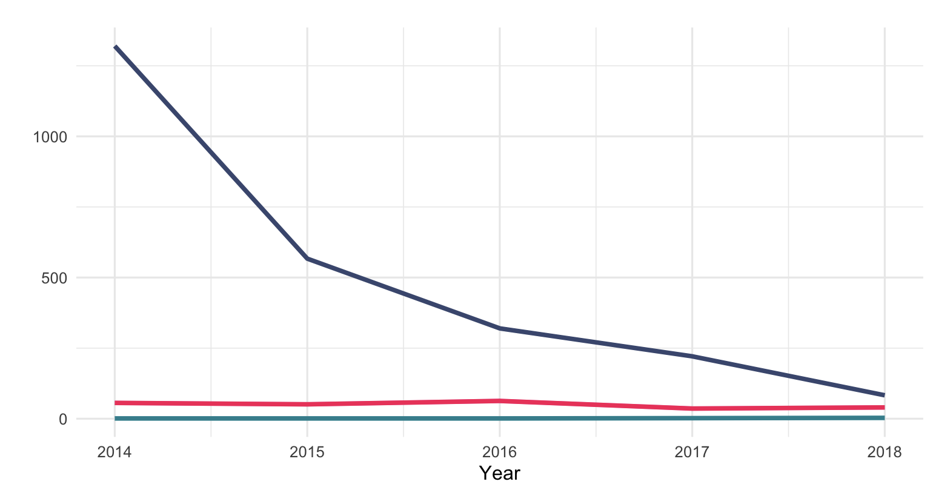
03 WHICH JOBS
Story Behind
Notes:
IBM - H1B Policy USCIS

Slide 19
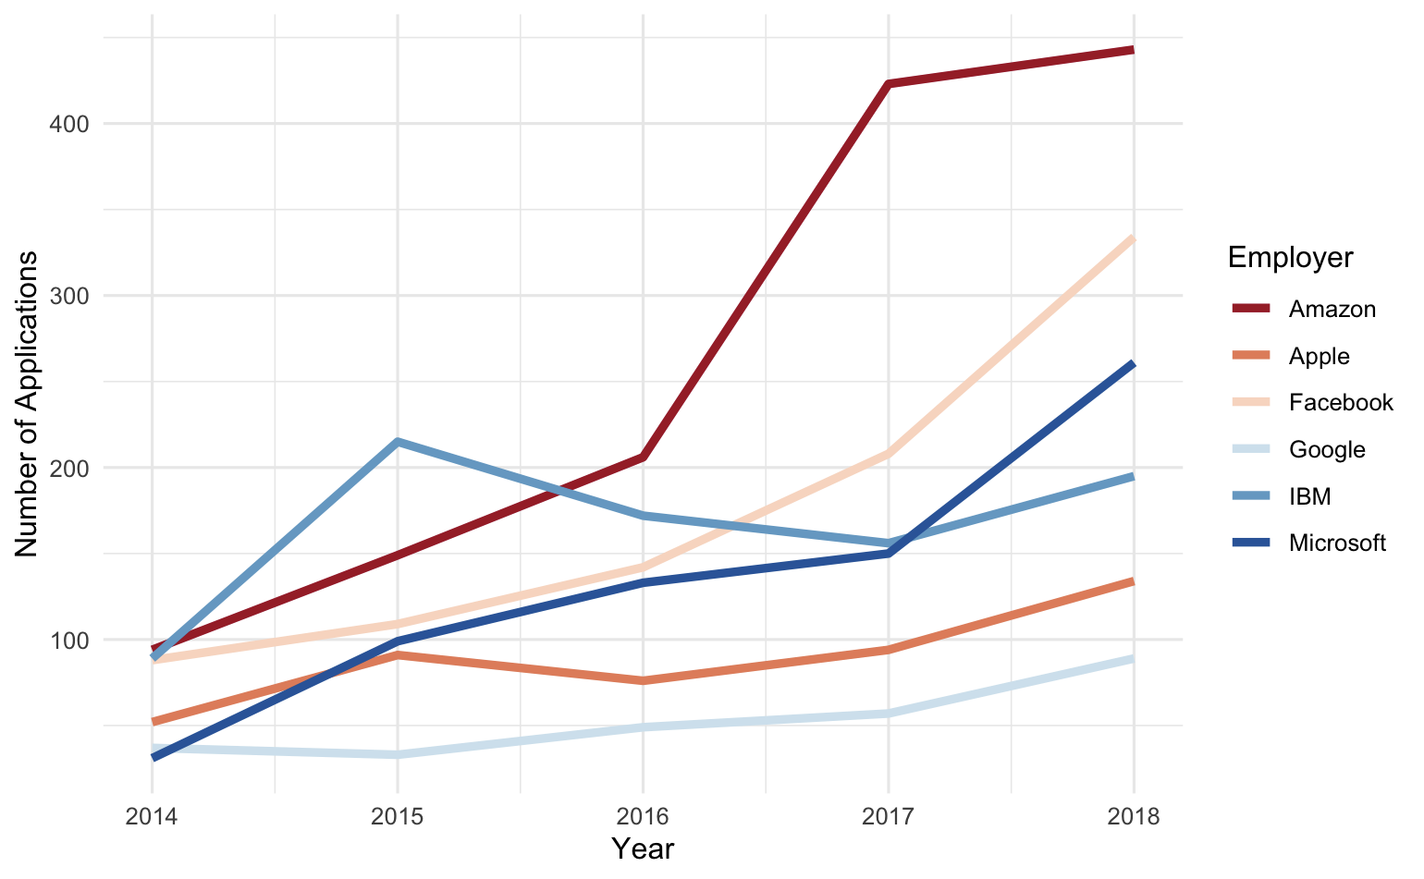
03 WHICH JOBS
Data Related Jobs In Tech Companies
Notes:
filter by data related jobs and and show how top tech companies trends have changed for those.

Slide 20

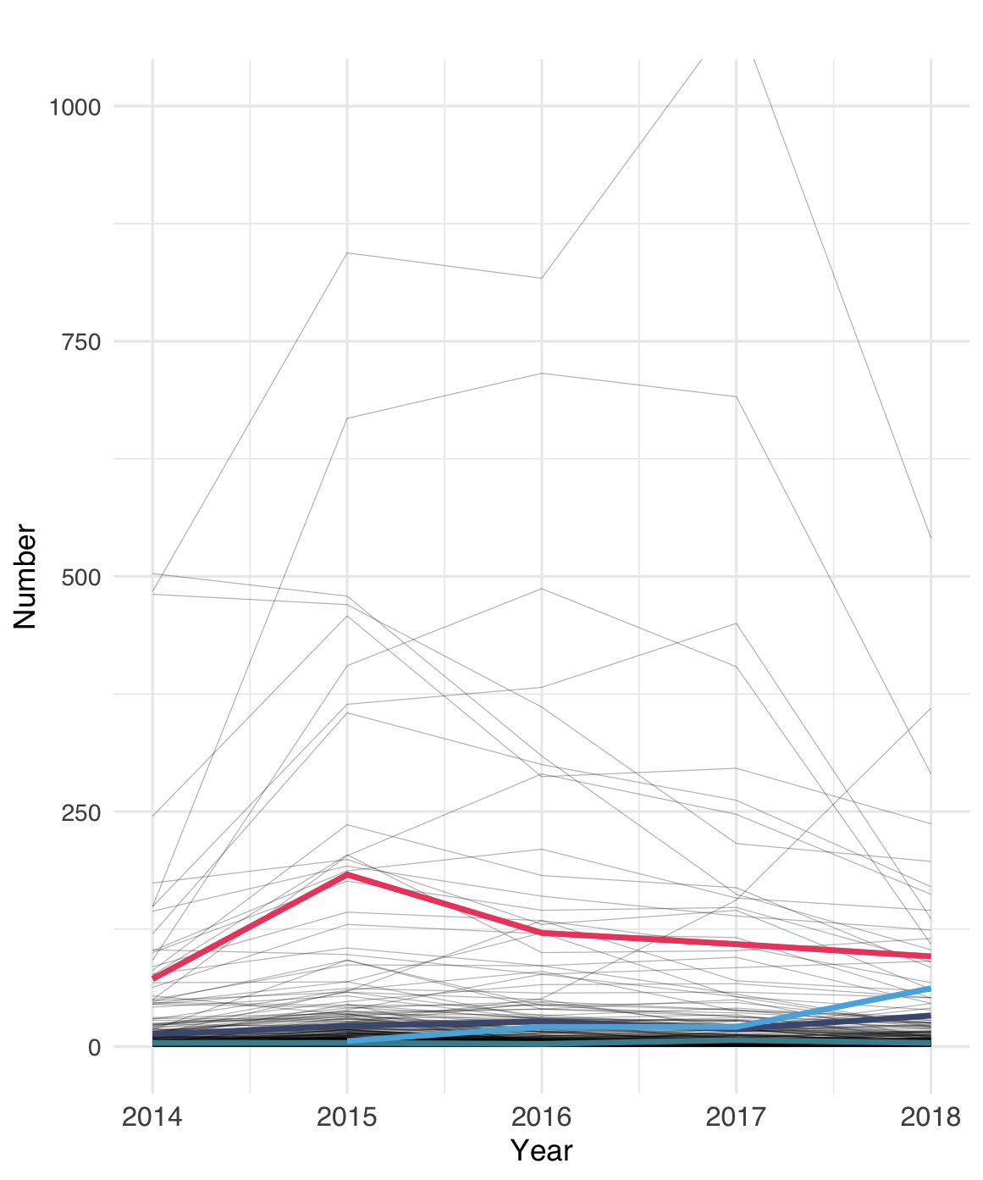
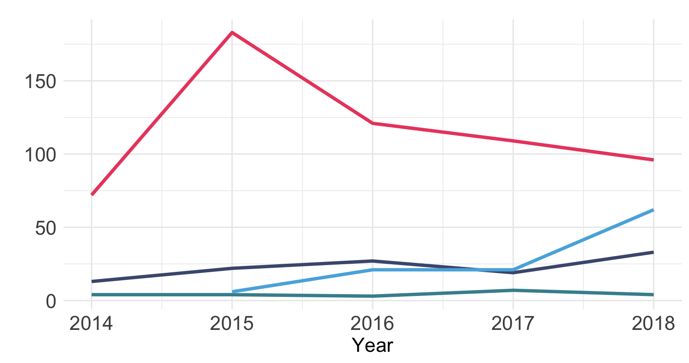
03 WHICH JOBS
Story Behind
Notes:
IBM - H1B Policy USCIS

Slide 21

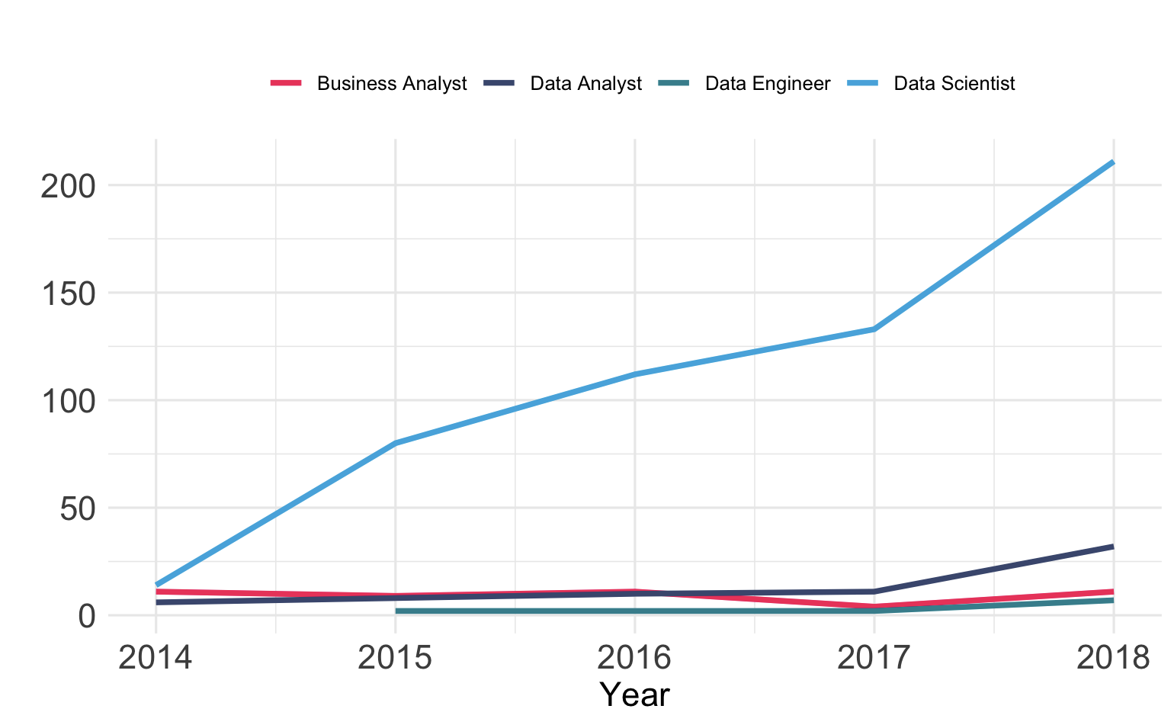
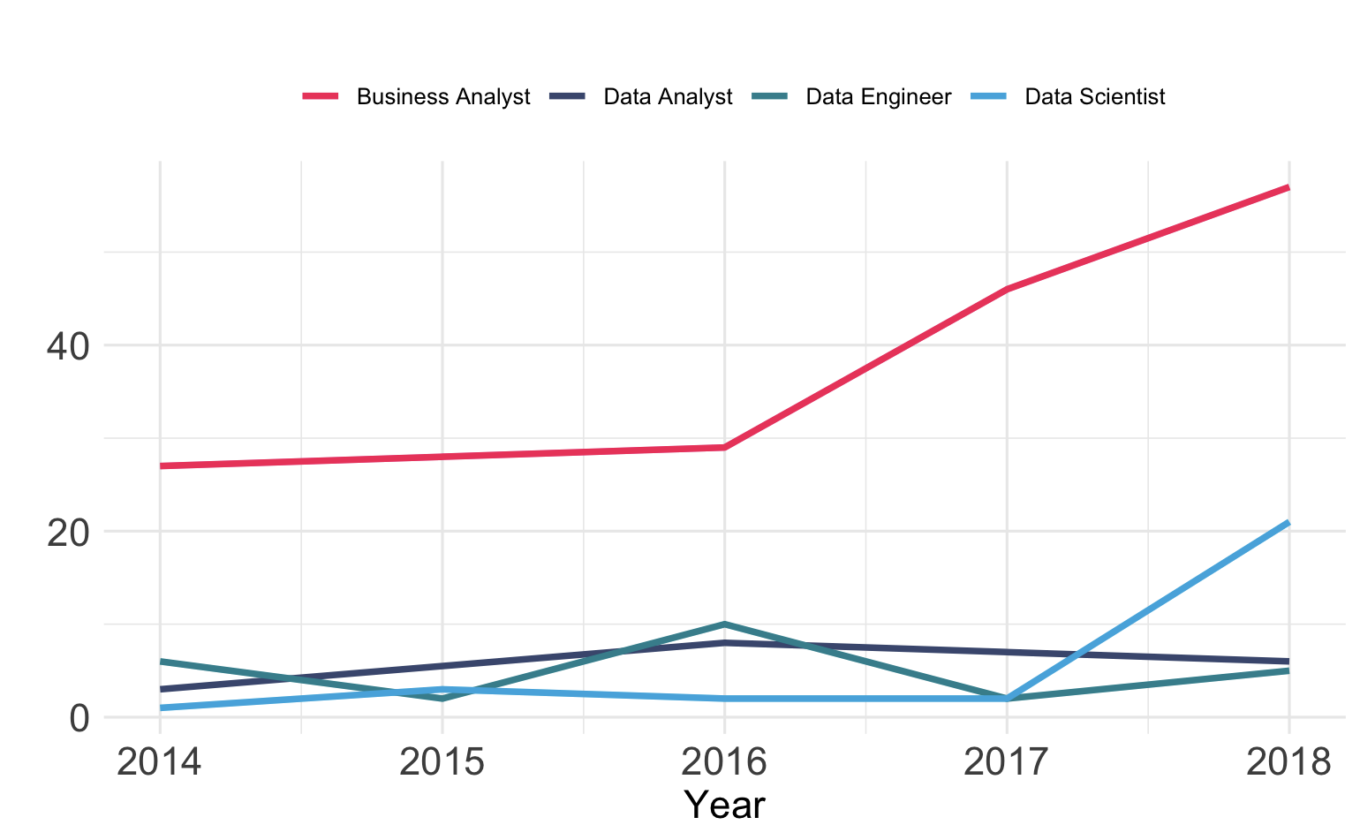

03 WHICH JOBS
Microsoft and Google
Comparatively, other tech giants, such as Microsoft and Google show a general increase in data related roles.
Interestingly, Google actually has very few directly data related roles.
Possibly because of data being used for all jobs in Google
Notes:
IBM - H1B Policy USCIS

Slide 22
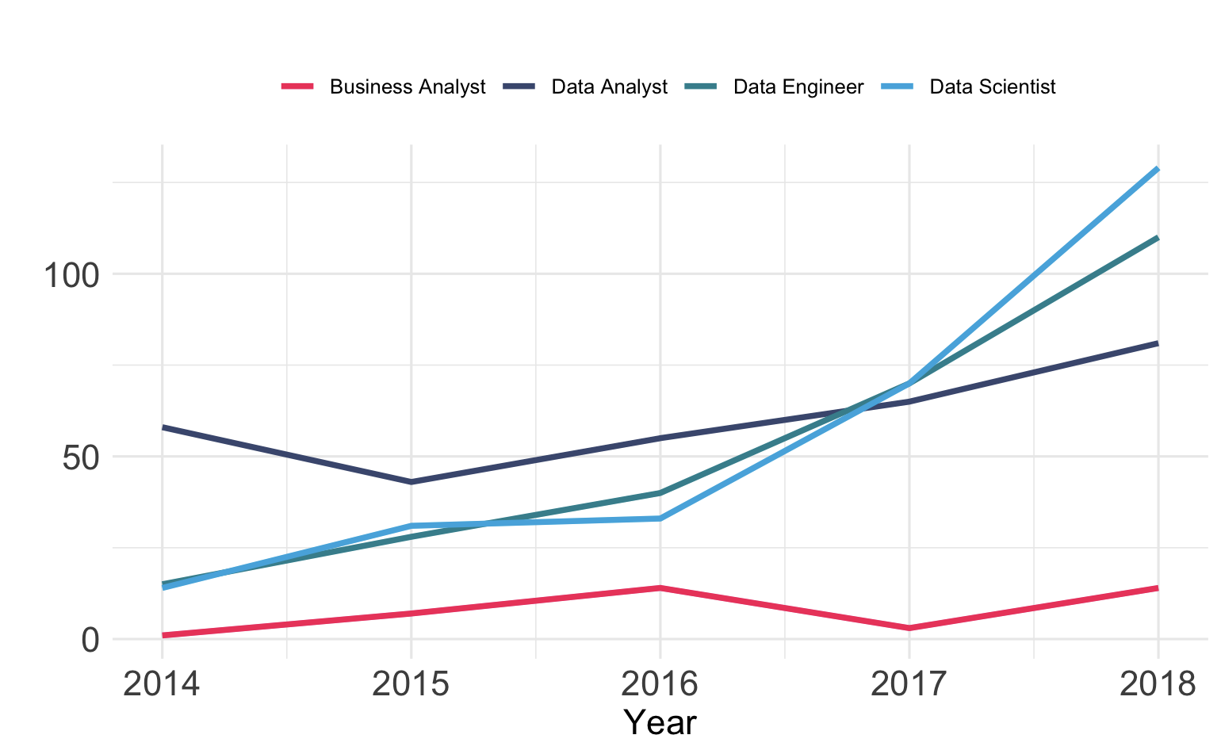

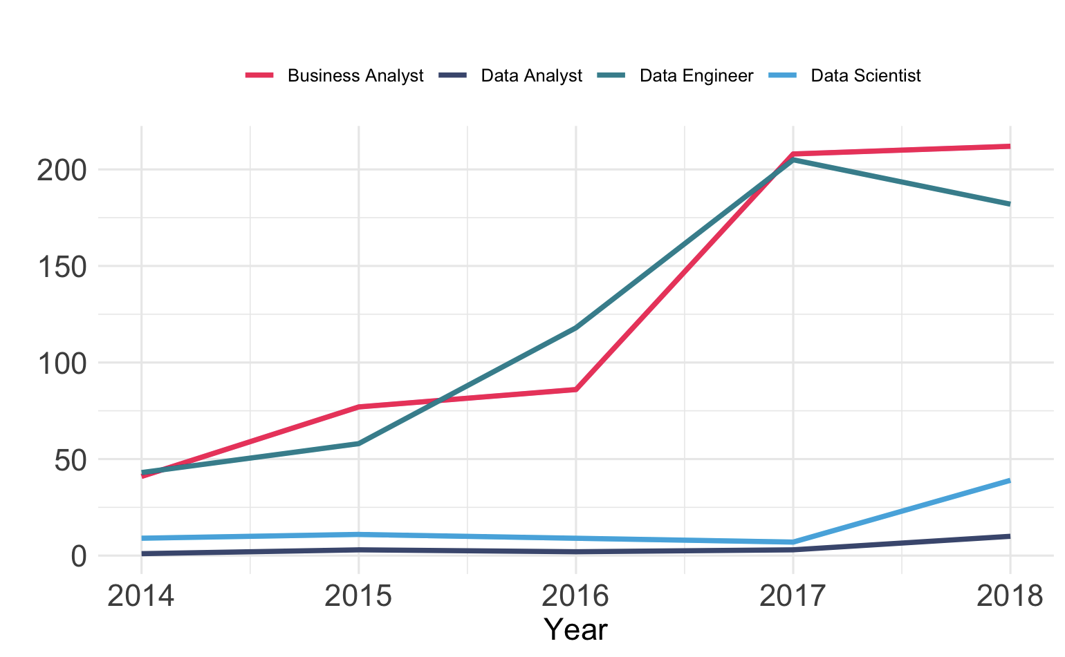

03 WHICH JOBS
Facebook and Amazon
Facebook showing an upwards increase in data related roles. Especially data science.
Amazon showing an overall increase in data related jobs.
Dip in 2017 due to higher regulations and work environment.
Notes:
IBM - H1B Policy USCIS

Slide 23
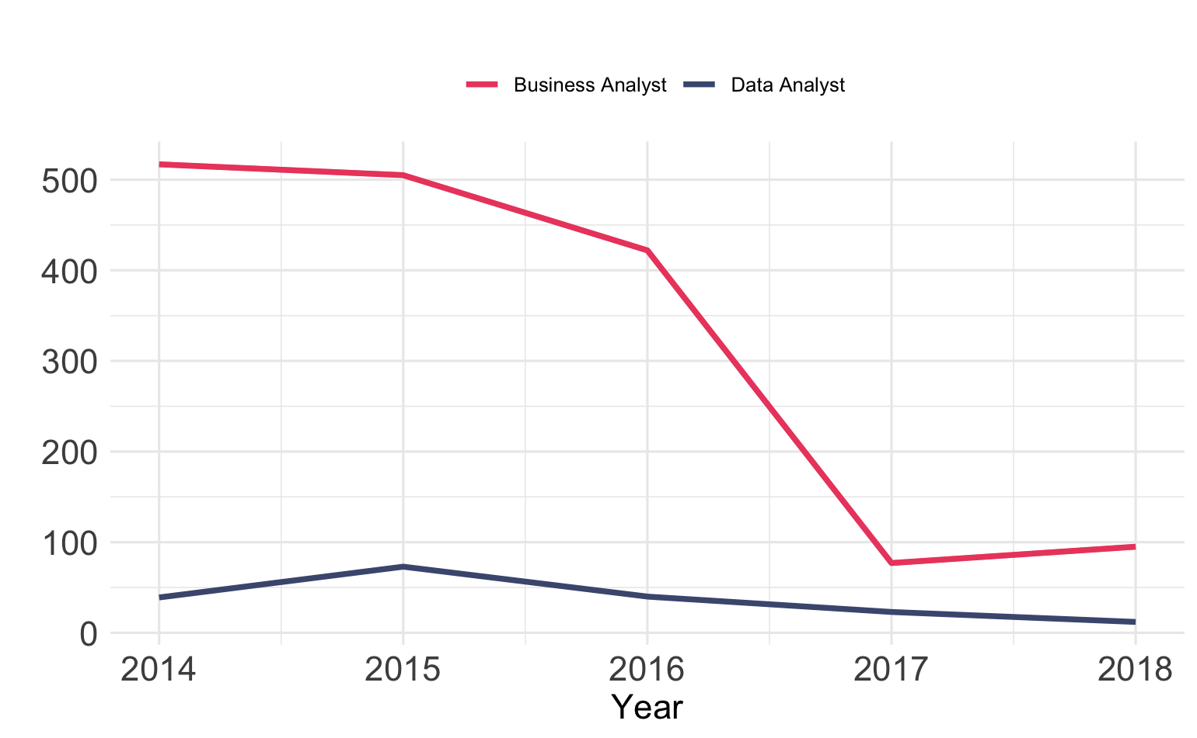


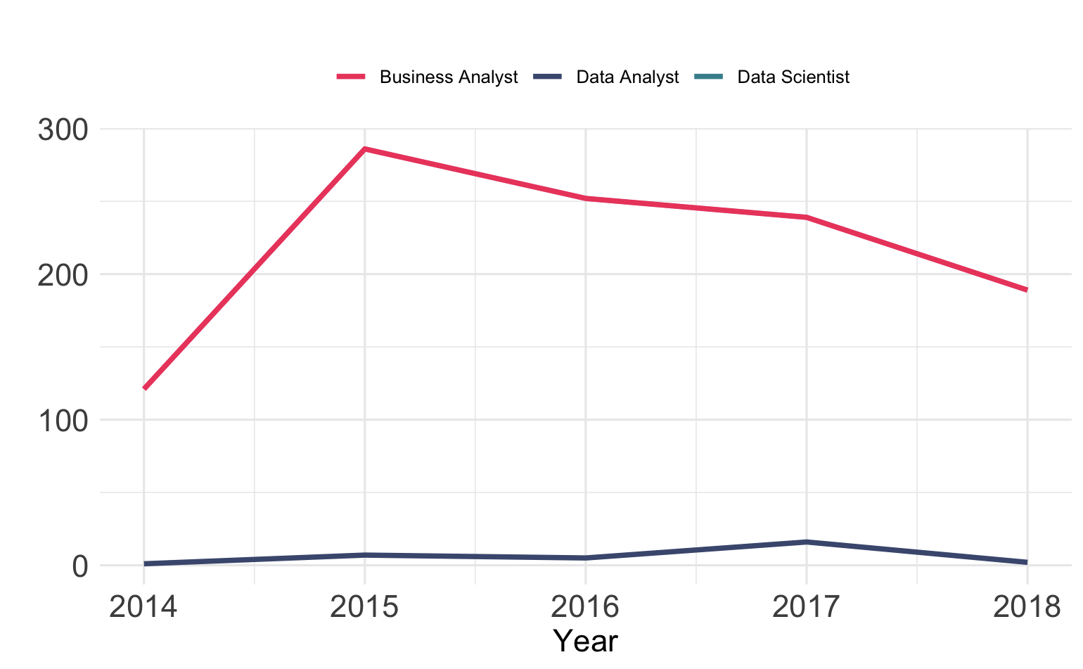
Consulting Firms
Consulting firm Deloitte, one of the top data job employers, see a lowering trend in data related jobs for international students.
We also see a similar trend in accenture, another consulting firm
Potential Reasons
Stricter H1B regulations
Travel restrictions
“Buy American, Hire American”
03 WHICH JOBS

Slide 24
04 WHERE
Where you should be applying for and what to look at
Notes:
WHERE, just means the location of the jobs. In this part, we will focus on that what’s the best location we should choose if we want to find some kinds of job.

Slide 25
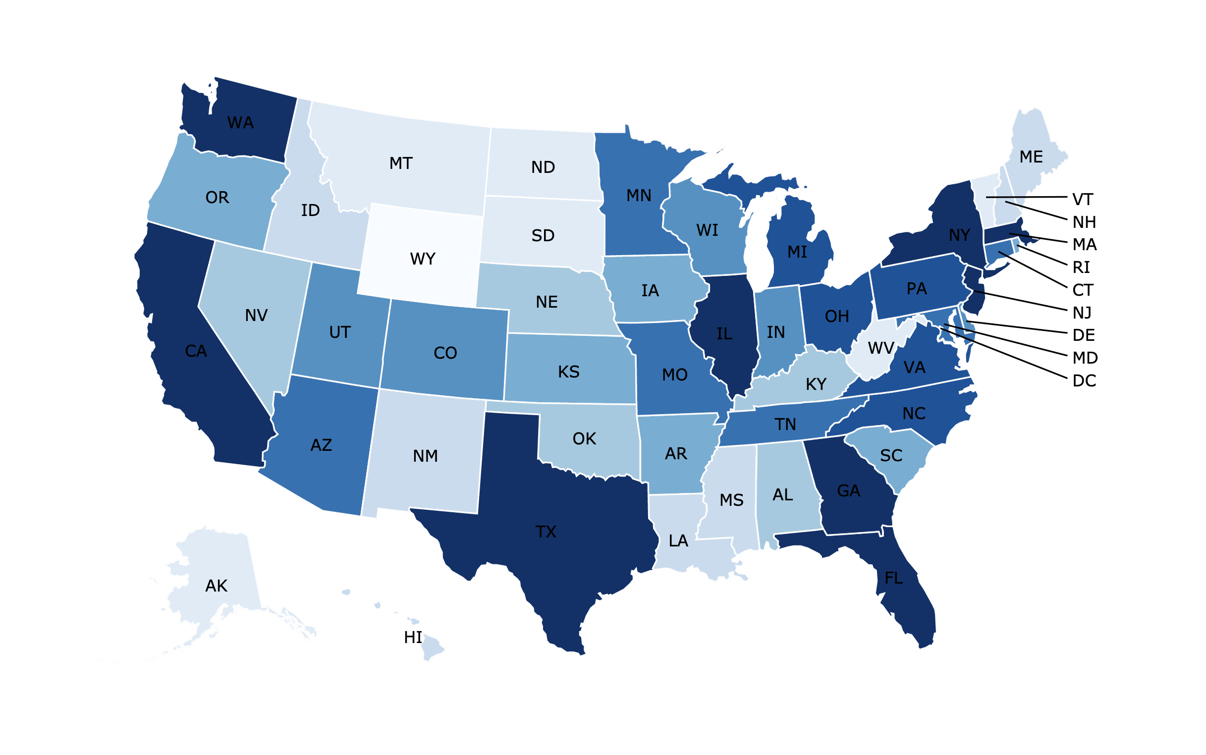
04 WHERE
Number of Data Jobs Per State in 2018
Notes:
California, Washington, Texas, New York darkest blue
CA - 7400
WY - 2 Data job in 2018

Slide 26
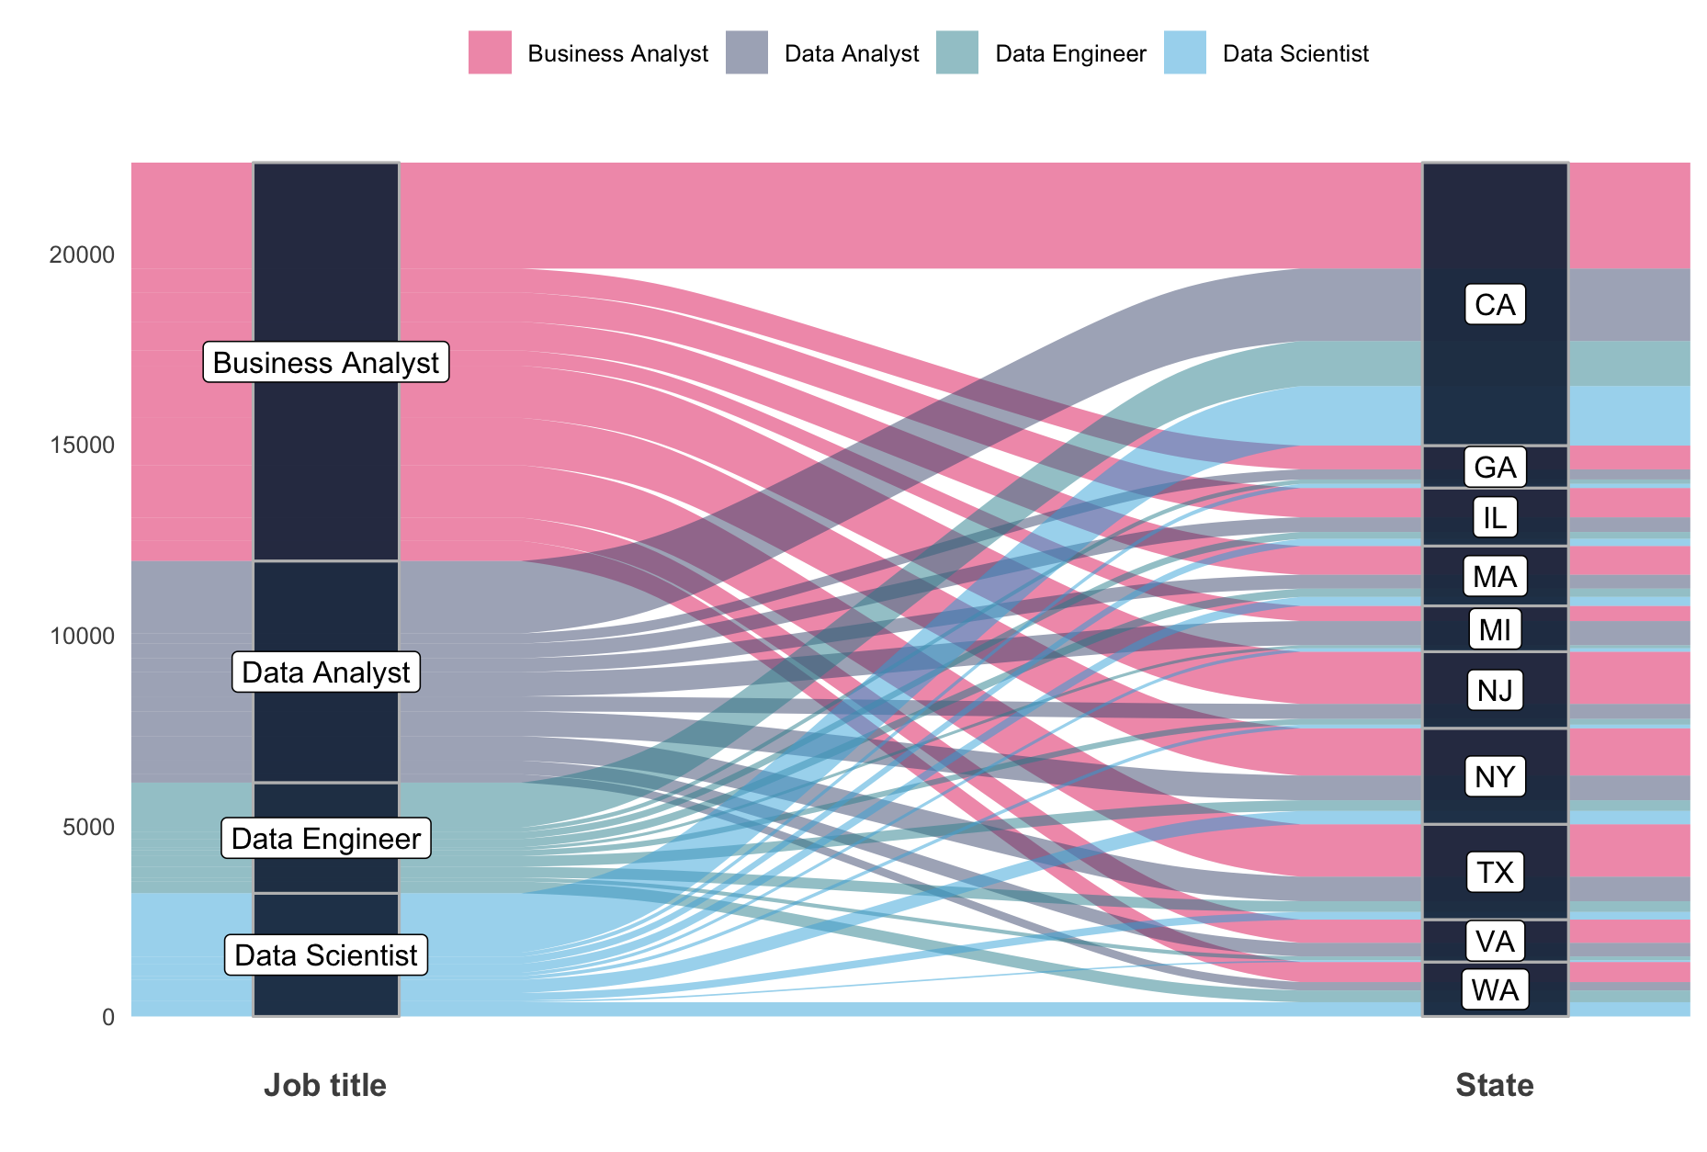
04 WHERE
Notes:
Michigan: DA > BA

Slide 27
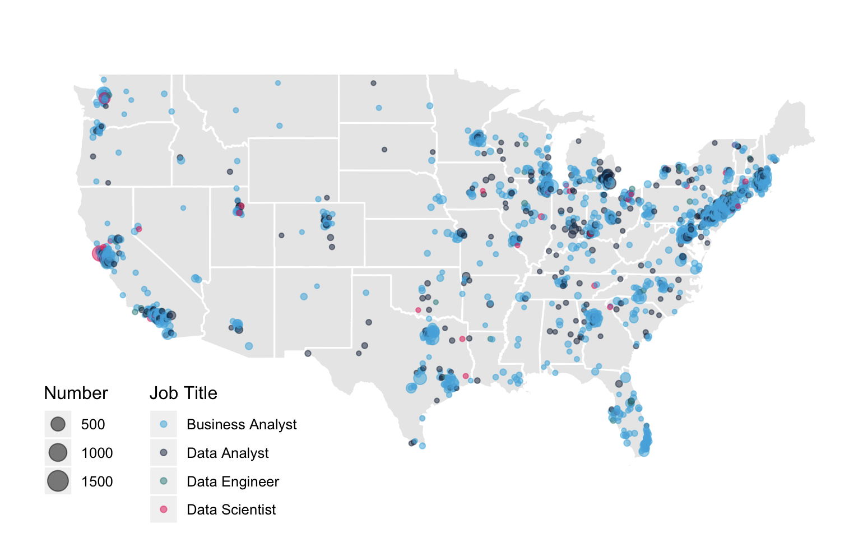
04 WHERE
1 Point = 1 City
Color = Data role with highest number of jobs in that city
Data jobs in USA National Wide
Notes:
EAST & WEST coast
Part of MIDWEST
Biggest point – New York city – 1799 Business Analyst
Business Analyst - New York city
Data Analyst – Dearborn(Detroit)
Data Scientist – San Francisco
WYOMING – 2 jobs, 2 job city

Slide 28
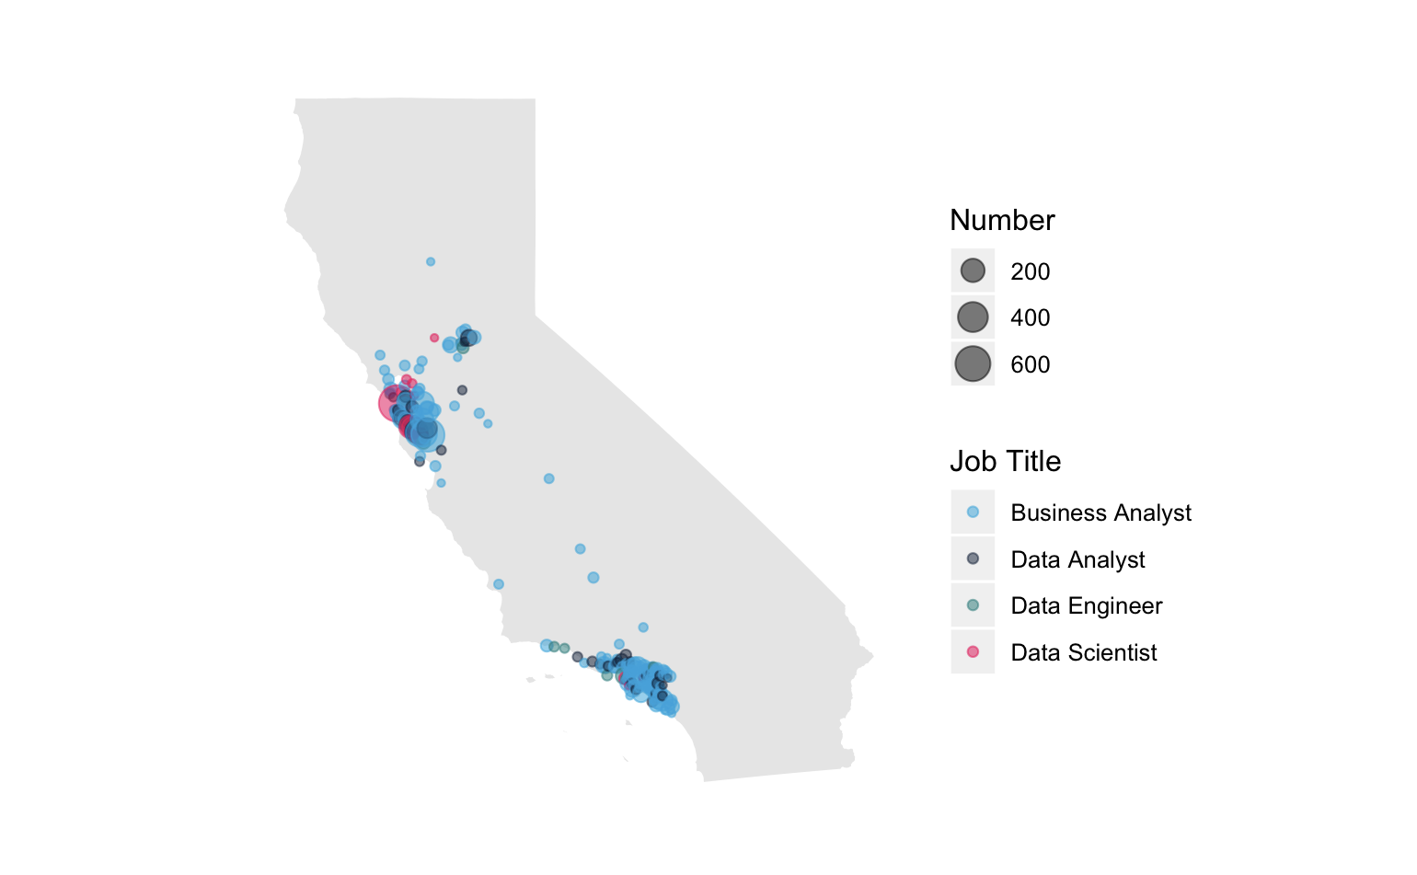
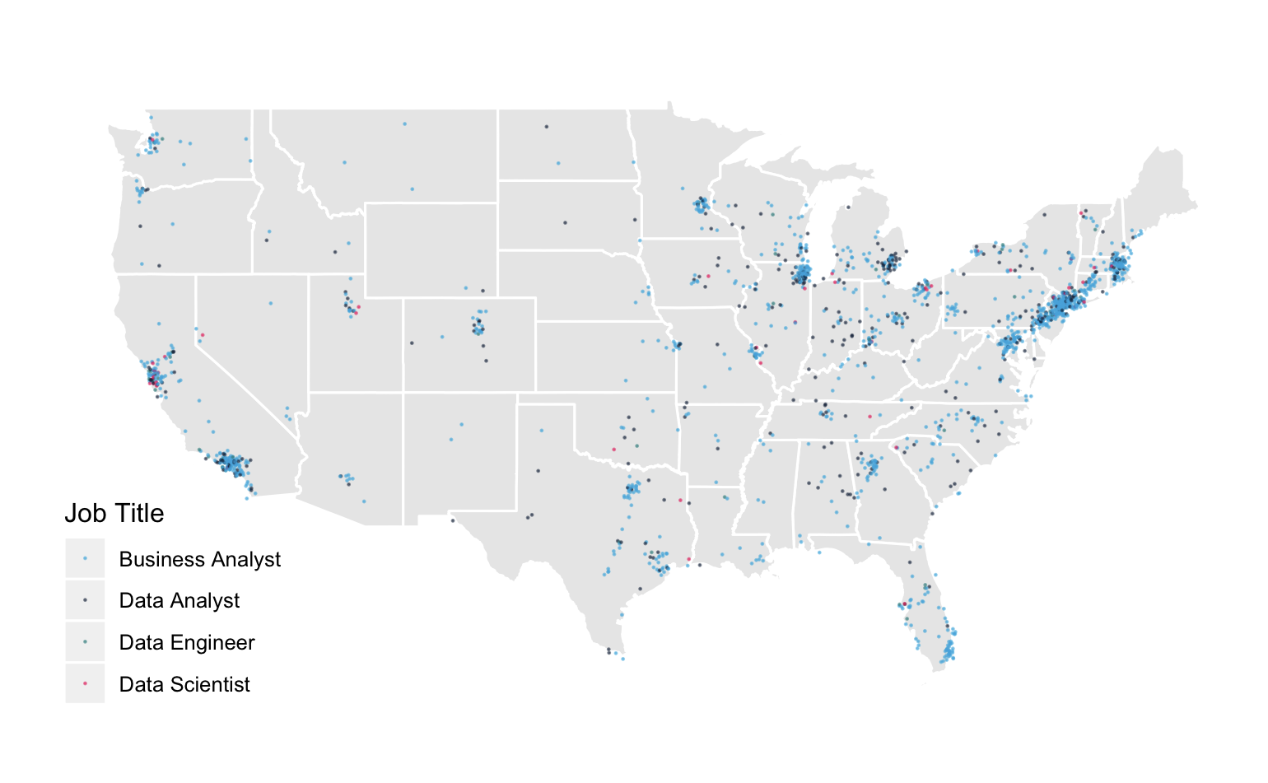
04 WHERE
Sacramento
Bay Area
Los Angeles
Data jobs in California
Notes:
Big RED point: San Francisco
Be a Data Scientist, Go to San Francisco!

Slide 29
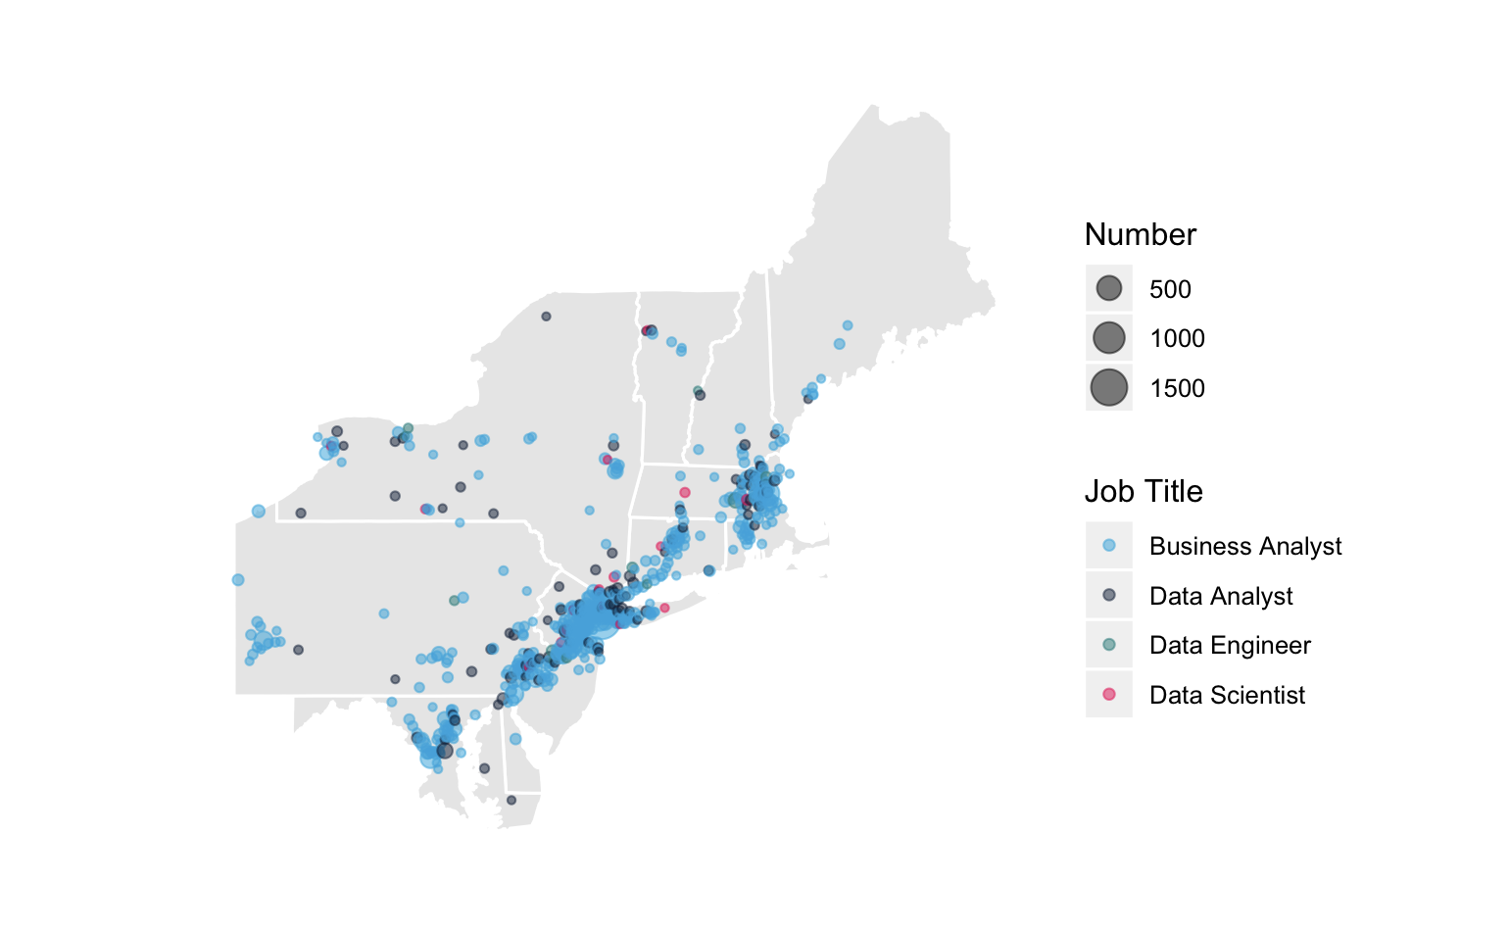
04 WHERE
Boston
New York
Philadelphia
Washington
Data jobs in Northeastern states
Notes:
Financial companies in east coast
Most of cities are business analyst city, some data analyst

Slide 30
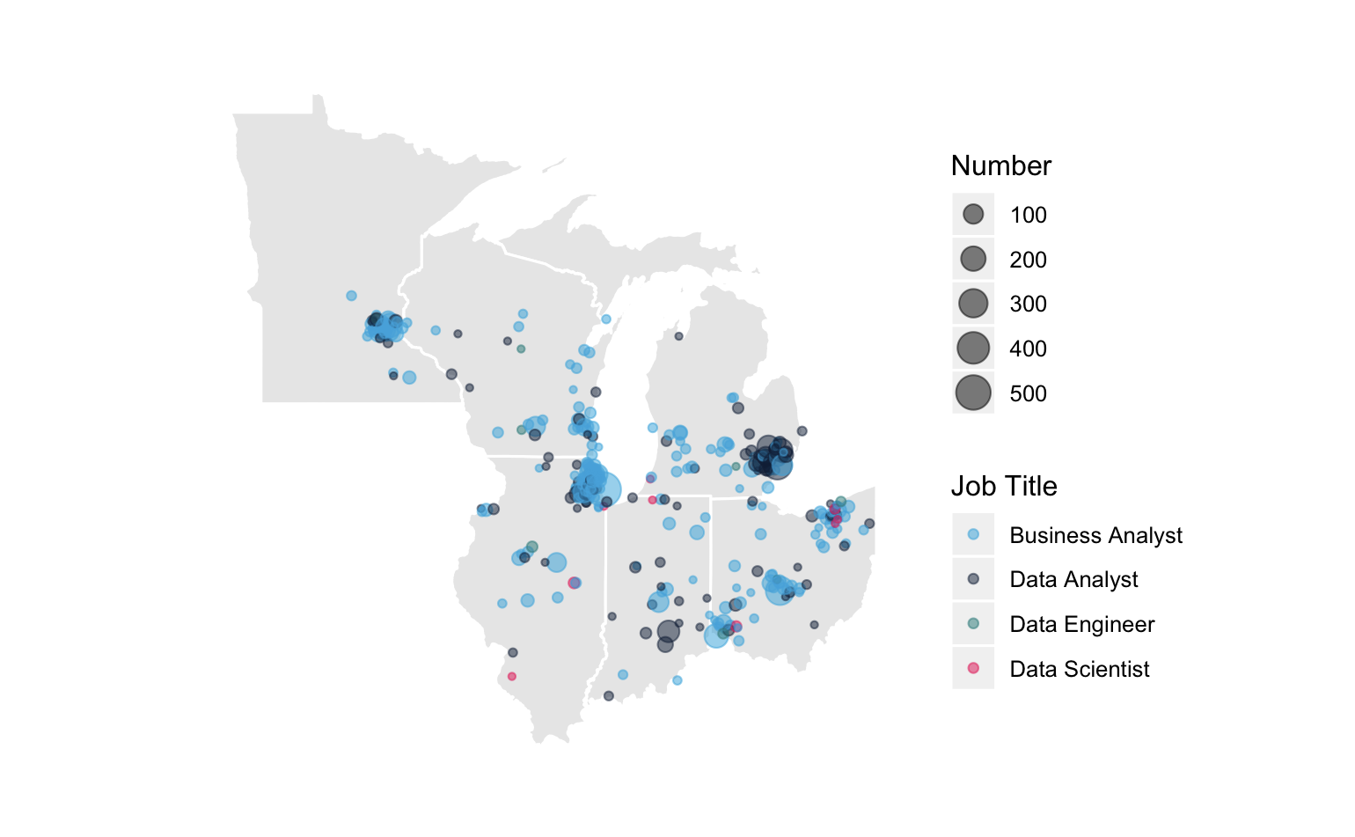
04 WHERE
Detroit
Chicago
Cleveland
Data jobs in Midwestern states
Notes:
Detroit - Data analyst
Mid west always need a lot of data analyst

Slide 31
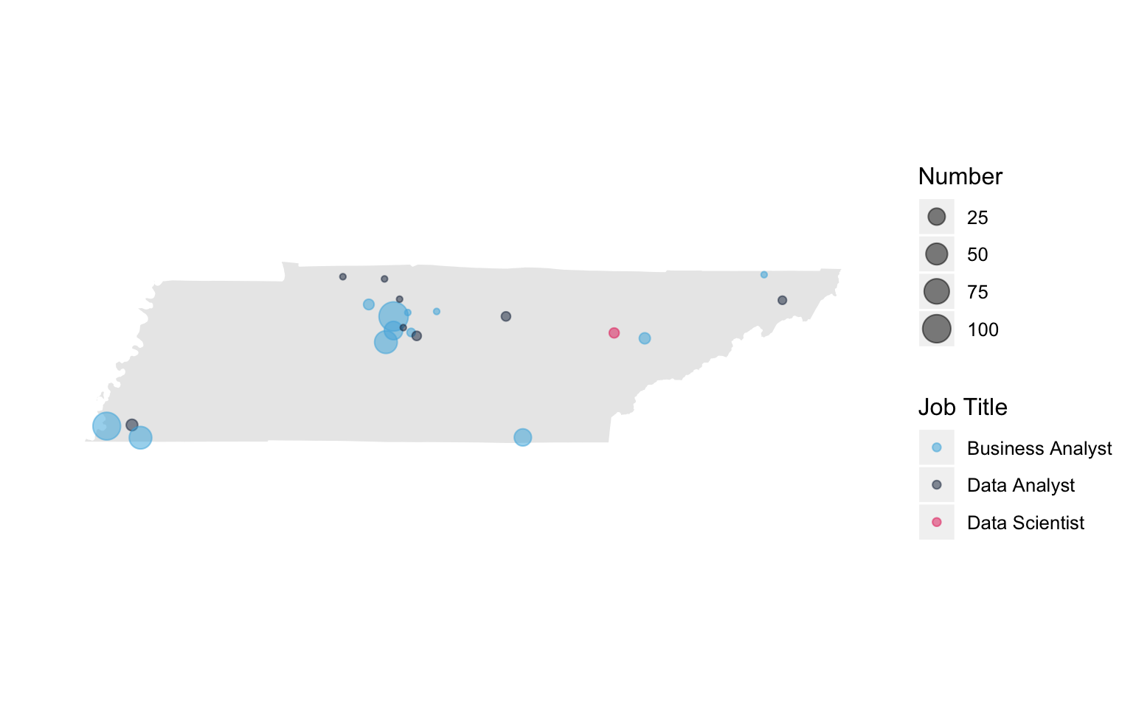
04 WHERE
Nashville
Memphis
Data jobs in Tennessee
Notes:
No DE
Size similar, number different
Data Scientist - Oak Ridge

Slide 32
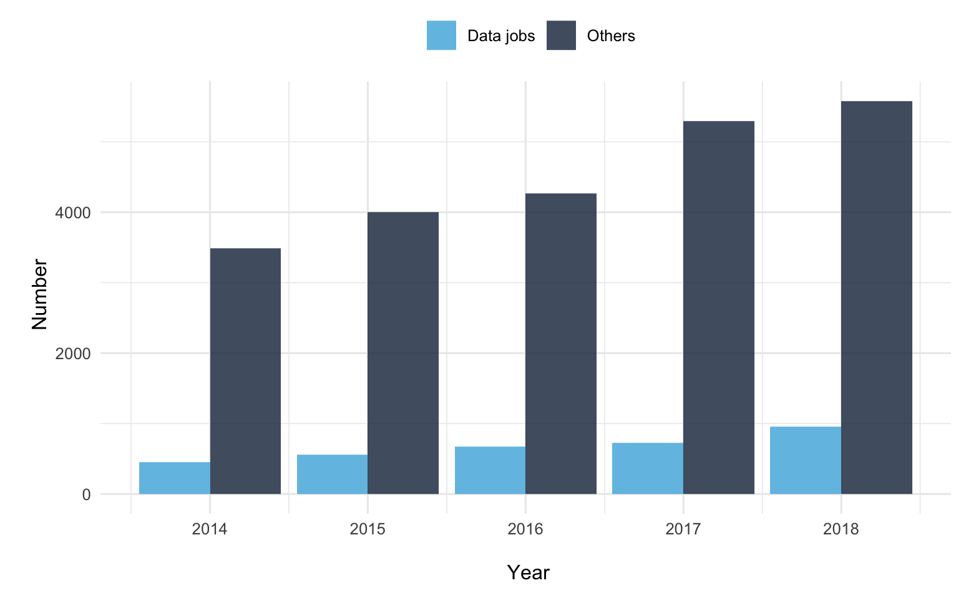
Data jobs in Tennessee
04 WHERE

Slide 33
Stricter regulations and large number of applications reduce the likelihood of getting an H1B visa
Highest number of Business Analyst/Analytics jobs available.
Consulting firms are riskier to apply to as they have been showing a downward trend due to the nature of the job.
Either coasts, and the midwest all good locations.
Relocation to CA very possible. TN having very few jobs.
05 CONCLUSIONS
Big takeaways

Slide 34
THINK
AND
GET JOBS
Helping the international data science students strategize job search,
through an analysis of H1B visa data of
3 million observations from 2014 to 2018.
Ali & His GG Queens
Ali Yaqoob
Yasi Wang, Yilin Yang, Zekun Wang

